Slide 1
Decision Trees & Random Forest
報告人:陳昭維、林禹陞
日期: 03/18/22

Slide 2
Outline
Decision Trees
Random Forests
Regression Trees
Comparing regression and classification performance

Slide 3
Outline
Decision Trees
Main concepts
Classification Trees and Implementation
Advantages
Overfitting and Inaccuracy
Random Forest
Regression Tree
Comparing regression and classification performance

Slide 4
Main concepts
Decision trees learn and sequentially apply a set of rules that split data points into subsets, then make prediction for each subset.
Splitting node and predict by greedy algorithm, which makes the largest impact to the current situation or optimizes the current status.
Gini impurity, Entropy, Classification error.
Can deal with non-numerical data more easily by encoding them without further or more complex preprocessing

Slide 5
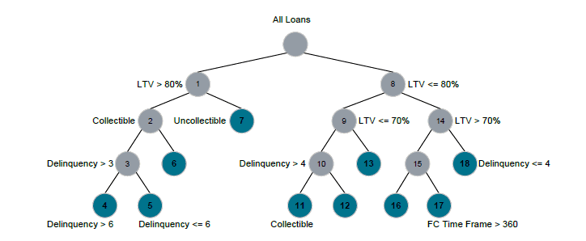

Slide 6
Classification Trees and Implementation
Learn splitting classification from the data.
Mechanism to determine whether splitting the node or not and using what classification to split node.
Different from linear regression or regression tree, which asks for minimum loss from those methods. We maximizes a specific value for each split or value that a node carries
Gini impurity is often implemented in this case.

Slide 7
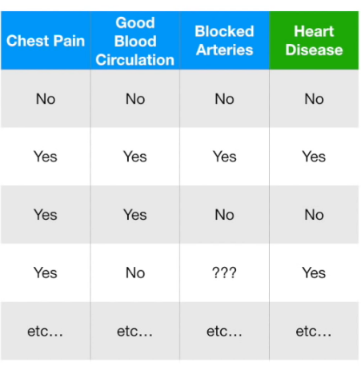
Classification Trees and Implementation
Starting with a case about how each symptoms predicts whether the test patient has heart disease.
In this case, we have 303 patients in total.

Slide 8
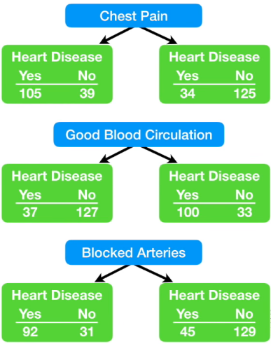
Classification Trees and Implementation

Slide 9
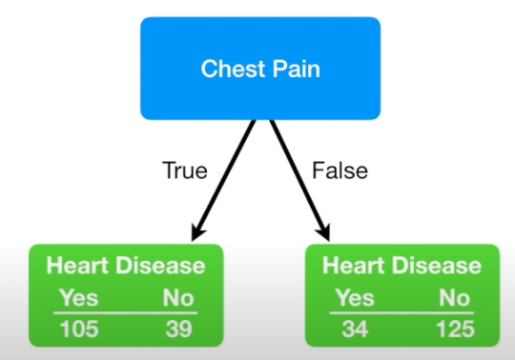
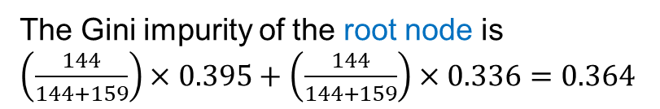
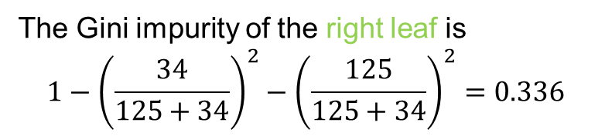
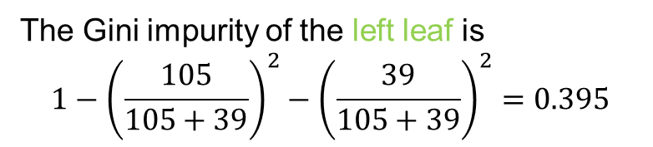
Classification Trees and Implementation
Gini impurity then comes in handy when deciding which classifier to use to split the node.
For a binary classifying case like this, the Gini impurity is
1-(the probability of “yes”)^2 – (the probability of “no”)^2
The Gini impurity of the left leaf is
$$1−{\left(\frac{105}{105+39}\right)}^{2}−{\left(\frac{39}{105+39}\right)}^{2}=0.395$$
The Gini impurity of the right leaf is
$$1−{\left(\frac{34}{125+34}\right)}^{2}−{\left(\frac{125}{125+34}\right)}^{2}=0.336$$
The Gini impurity of the root node is
$\left(\frac{144}{144+159}\right)×0.395+\left(\frac{144}{144+159}\right)×0.336=0.364$

Slide 10
Classification Trees and Implementation
Gini Impurity
0.364
0.360 , This is smallest Gini impurity value, thus we use it as root node.
0.381

Slide 11
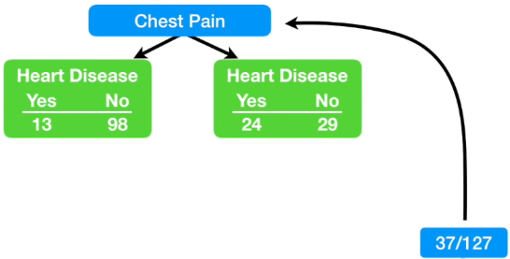
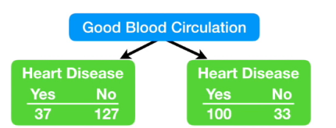
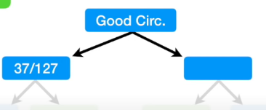
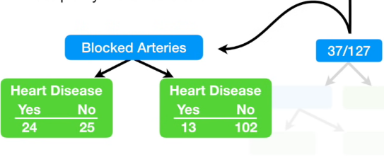
Classification Trees and Implementation
Gini impurity for chest pain = 0.3
Gini impurity for blocked arteries = 0.29

Slide 12
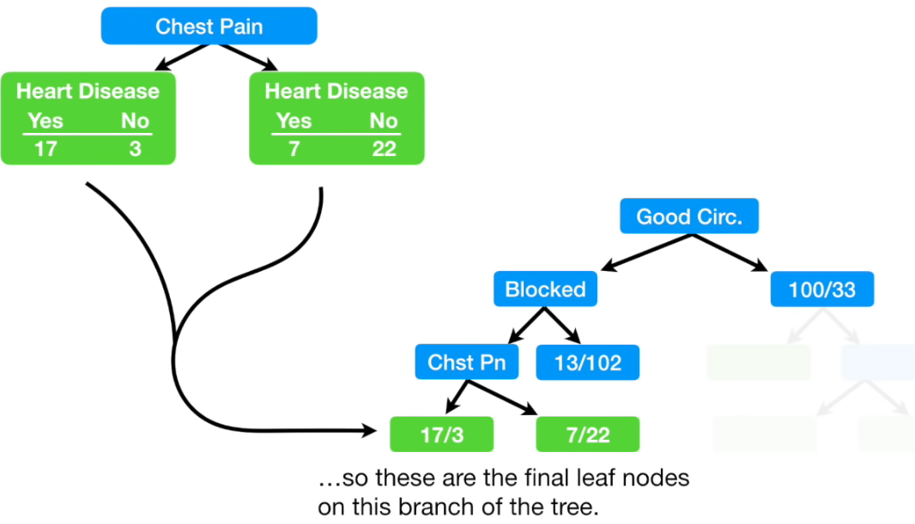
Classification Trees and Implementation

Slide 13
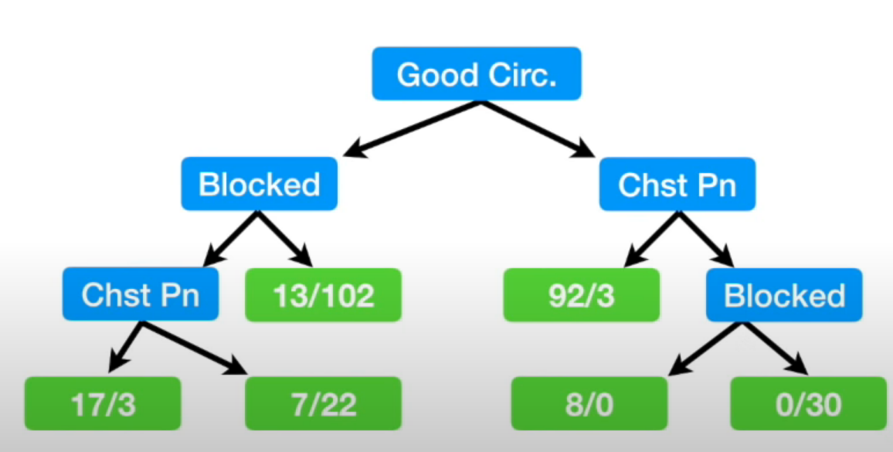
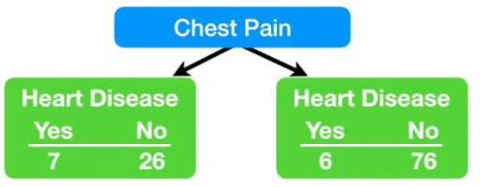
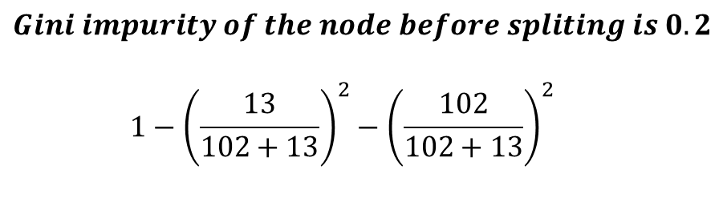
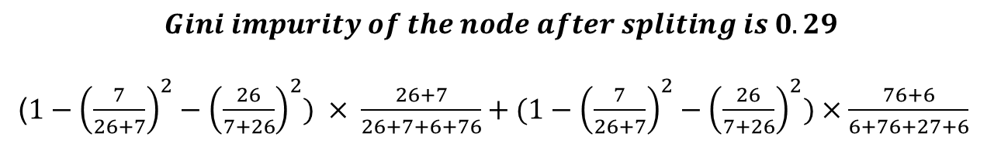
Classification Trees and Implementation
$$Gini impurity of the node after spliting is 0.29$$
($1−{\left(\frac{7}{26+7}\right)}^{2}−{\left(\frac{26}{7+26}\right)}^{2}) × \frac{26+7}{26+7+6+76}+(1−{\left(\frac{7}{26+7}\right)}^{2}−{\left(\frac{26}{7+26}\right)}^{2})×\frac{76+6}{6+76+27+6}$
$$Gini impurity of the node before spliting is 0.2$$
$$1−{\left(\frac{13}{102+13}\right)}^{2}−{\left(\frac{102}{102+13}\right)}^{2 }$$

Slide 14
Classification Trees and Implementation
Dealing with numerical data with similar approach
Sort the data
Calculate average value between each labels.
Calculate impurity value for each average value as splitting threshold.
Dealing multiple choices with similar approach
Creating choice combination with it’s power set
E.g. set of {red, green, blue} then {green, blue} is one way
Then calculate the impurity score that we did before.

Slide 15
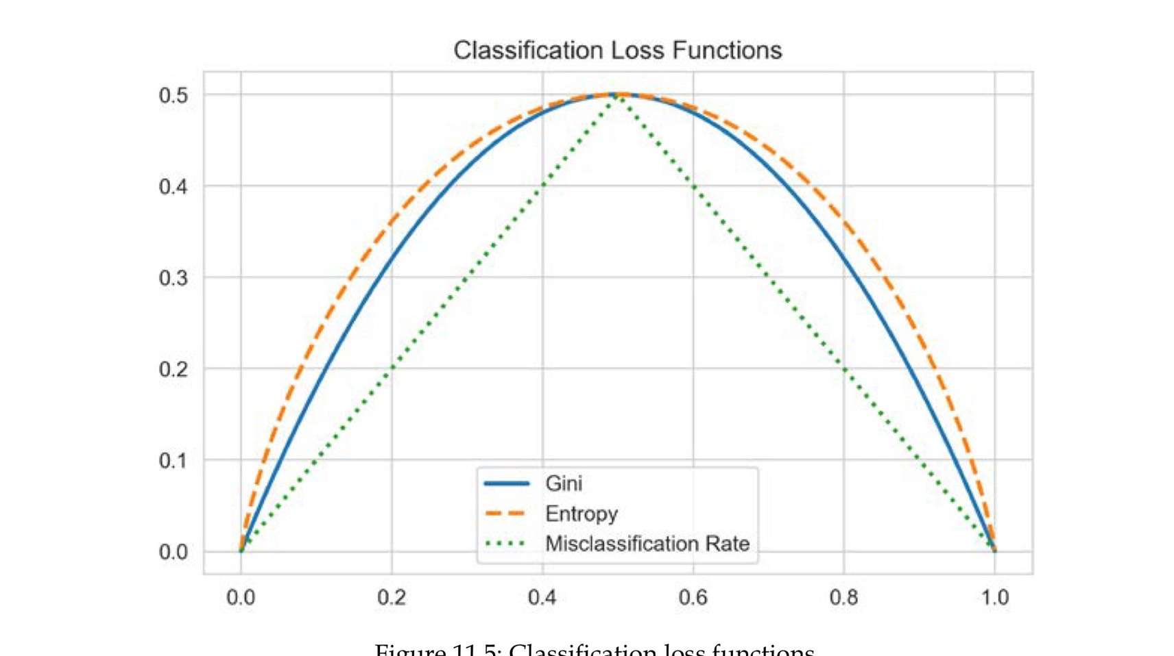
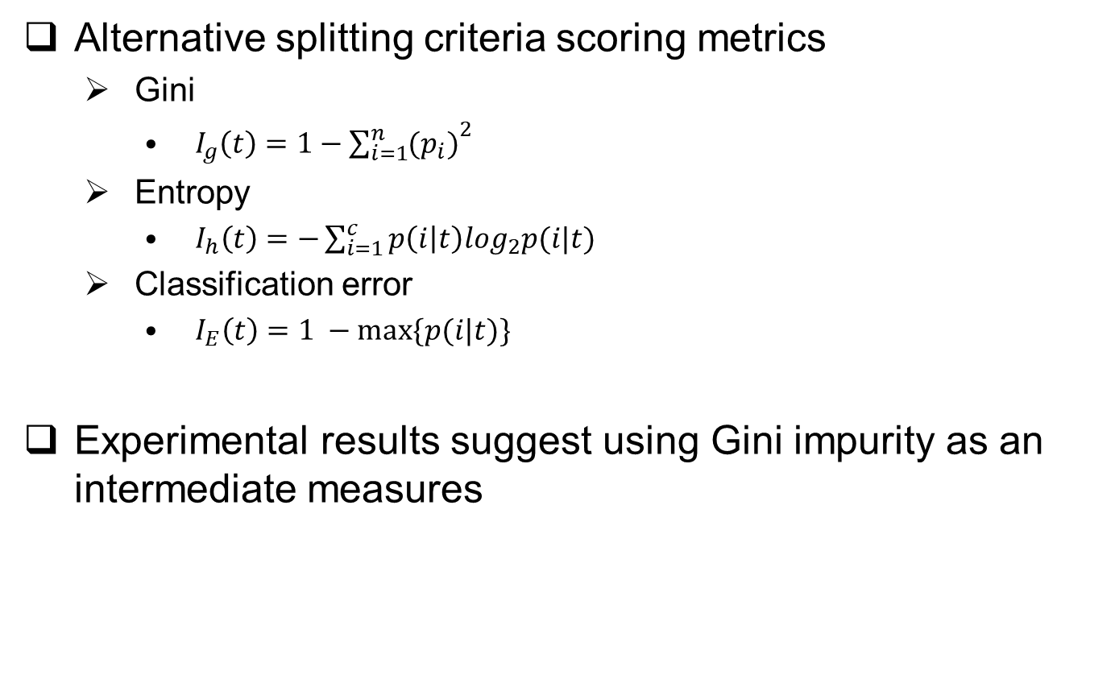
Classification Trees and Implementation
Alternative splitting criteria scoring metrics
Gini
$I_{g}\left(t\right)=1−{\sum_{i=1}^{n}{{(p}_{i})}}^{2}$
Entropy
$I_{h}\left(t\right)=−\sum_{i=1}^{c}{p\left(i | t\right)\log_{2}p(i|t)}$
Classification error
$I_{E}\left(t\right)=1 −max⁡\{p(i|t)\}$
Experimental results suggest using Gini impurity as an intermediate measures

Slide 16
Advantages
Straight forward interpretation, easily visualized.
White-box models by clearly presenting training and classifying procedure
Require less data preparation and are more sensitive to outlier.
Prediction is fast for balanced tree class.

Slide 17
Overfitting and Inaccuracy
Decision tree have a strong tendency to overfit due to the strong informative splitting method.
There are few ways to address with this issue
Tree pruning: eliminates nodes when the node increases variance in contrast to it’s affect on the whole tree.
Dimensionality reduction: which makes feature to sample ratio better.
Ensemble model: creating random forests

Slide 18
Outline
Decision Trees
Random Forests
Bootstrapping
Bagging– Building Random Forest
Out-of-Bag testing
Pros and Cons
Regression Trees
Comparing regression and classification performance

Slide 19
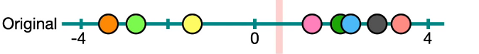
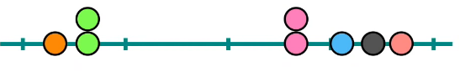
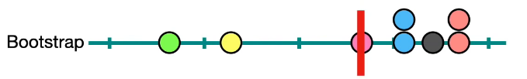
Bootstrapping
Create dataset with replacement

Slide 20
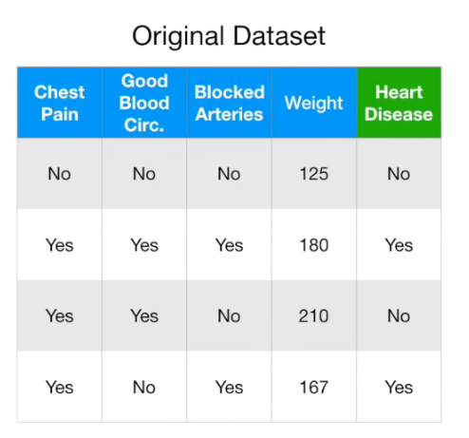
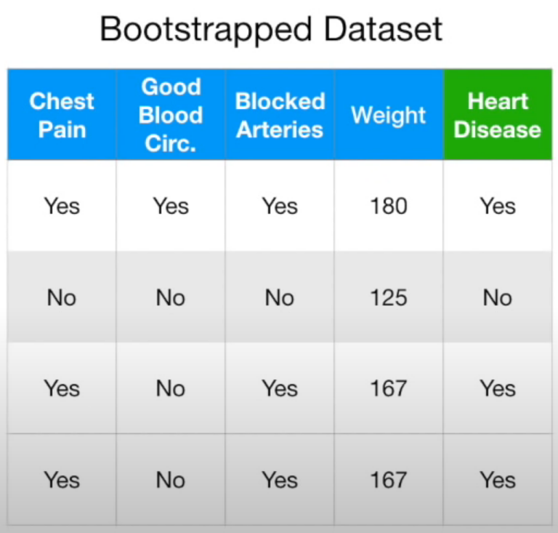
Bagging– Building Random Forest
Using previous examples, we now create bootstrap datasets with replacement.

Slide 21
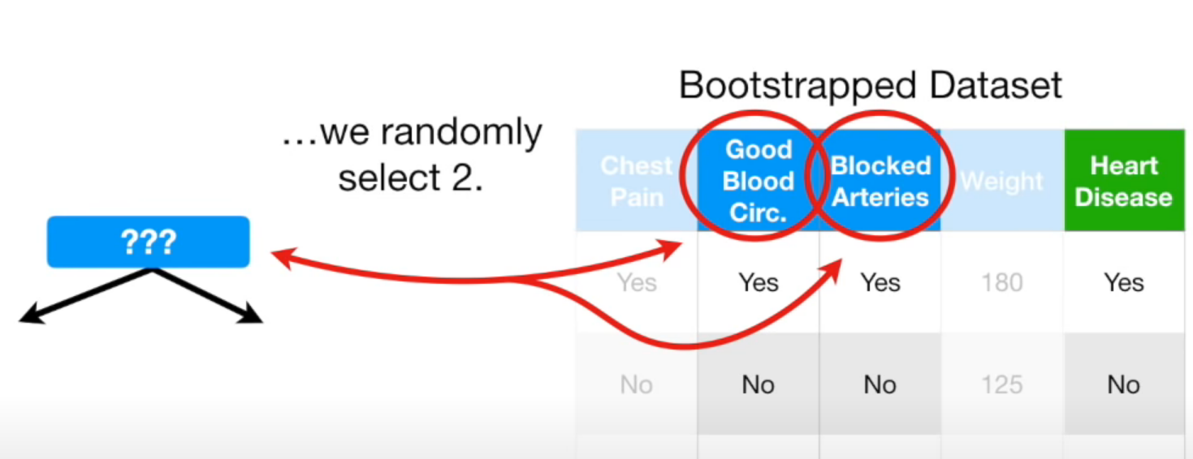
Bagging– Building Random Forest
Create decision tree using the bootstrapped dataset, but only selects random subset of variables at each step
In this case we consider 2 variables at each step out of 4

Slide 22
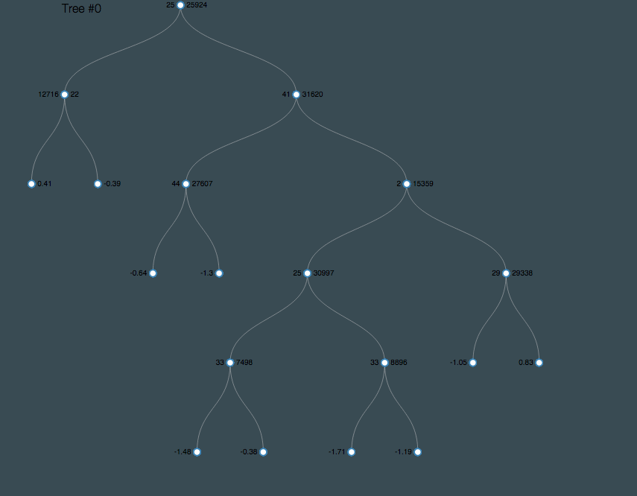
Bagging– Building Random Forest
Then we repeat the bootstrap and select random feature subset to create multiple decision trees

Slide 23
Bagging– Building Random Forest
After creating the random forest for a certain amount, test the dataset with all the decision trees in this random forest
Averaging over a set of an individual observations reduces the variance
Bagging work extremely well with overcomplicated and overfitted models and ensemble model statistically shown that it is good with lowering the variance of a low bias high variance model.

Slide 24
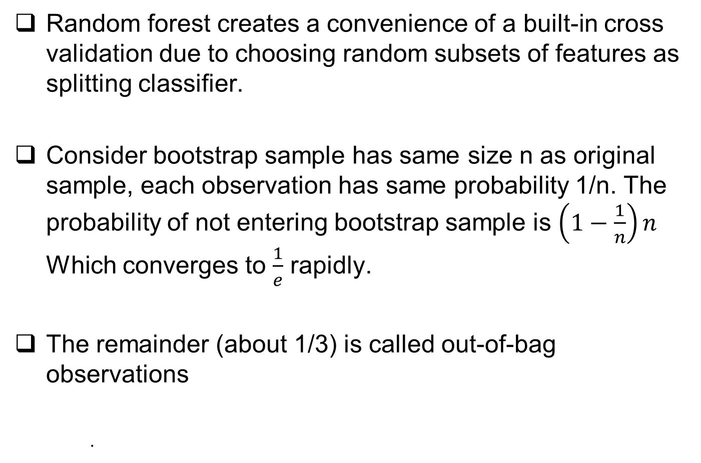
Out-of-Bag Testing
Random forest creates a convenience of a built-in cross validation due to choosing random subsets of features as splitting classifier.
Consider bootstrap sample has same size n as original sample, each observation has same probability 1/n. The probability of not entering bootstrap sample is $\left(1−\frac{1}{n}\right)n$ Which converges to $\frac{1}{e}$ rapidly.
The remainder (about 1/3) is called out-of-bag observations
.

Slide 25
Out-of-Bag Testing
For more complex approach, we can compare the out-of-bag error for a random forest between different sizes of random subspaces of features
The previous example uses 2 from the 4 variables.
We need to avoid lookahead bias caused by out-of-order OOB observation which is likely to happen in time series data if we don’t handle it carefully.

Slide 26
Pros and Cons
Advantages
Properly used, random forest can outperform any other model.
Provides a reliable feature importance estimation.
Offer efficient estimations of the test error without incurring the cost of repeated model training associated with cross-validation.

Slide 27
Pros and Cons
Disadvantages
Ensemble model is inherently less interpretable than individual tree.
Training a large number of deep depth tree have high computational cost and memory.
Predictions are slower in general, creates challenges for low latency especially in high frequency trading.

Slide 28
Outline
Decision Trees
Random Forests
Regression Trees
Comparing regression and classification performance

Slide 29
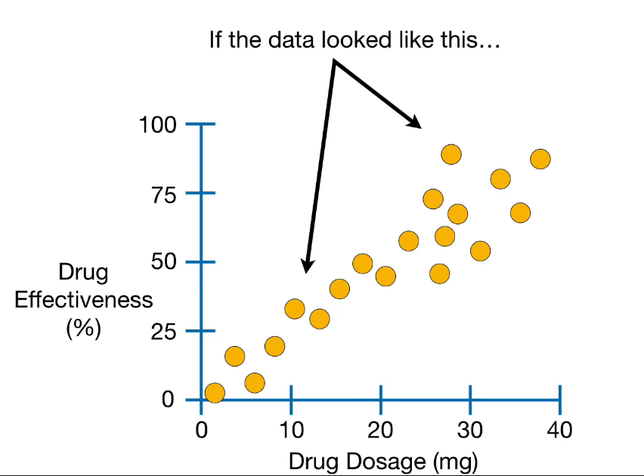
Regression Trees
If the data follows the representation, then a simple OLS can be performed by calculating the loss.
Take drug dosage to predict drug effectiveness.

Slide 30
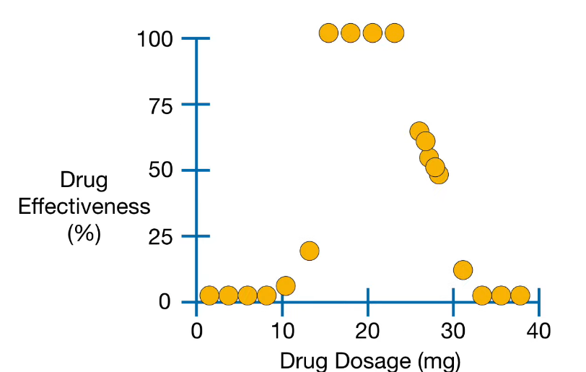
Regression Trees
Real case data, where there is no significant linear relationship between features and label

Slide 31
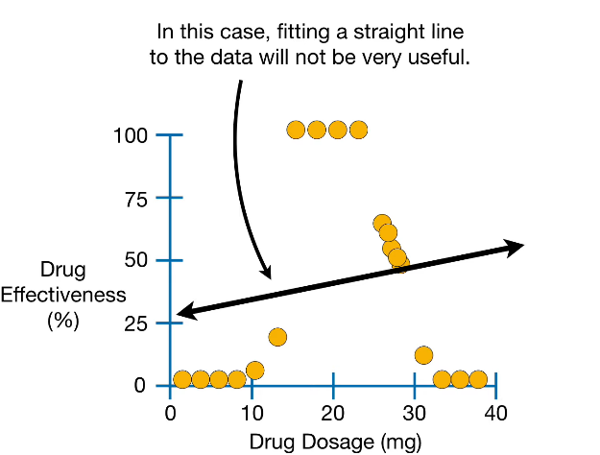
Regression Trees
From previous graph, we can label the data into 4 main clusters.
Low dosages that are not effective.
Moderate dosage that are extremely work really well
Some higher dosages work about 50% effectiveness
High dosages are not effective at all

Slide 32
Regression Trees
This is when regression tree comes in handy, dealing with data that has no specific linear relationship or multiple outliers.
Regression tree is another class of decision tree
Each leaf represents a numerical value.

Slide 33
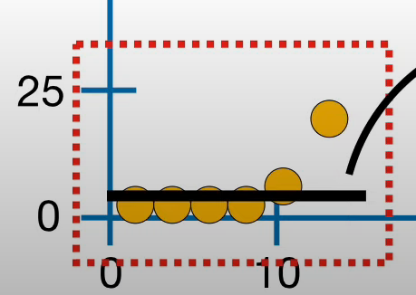
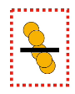
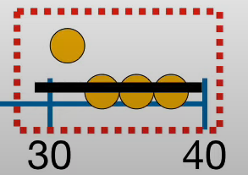
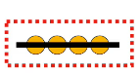
Regression Trees
People that uses dosage less than 14.5 mg has average drug effectiveness of 4.2% in average.
People that uses dosage more than 14.5 and more than 29mg have effectiveness of 2.5% in average.
People that uses more than 14.5 mg more than 23.5 mg but less than 29 mg has effectiveness of 100% in average.
Then people who uses in the range of 14.5mg and 23.5mg has effectiveness of 52.8% effectiveness in average.

Slide 34
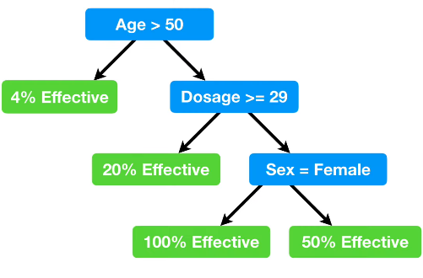
Regression Trees
What is strong about the regression trees lies within that it can uses with data with multiple numerical predictors.
Such as previous example but with dosage, sex, age, diet habit and more so as predictors

Slide 35
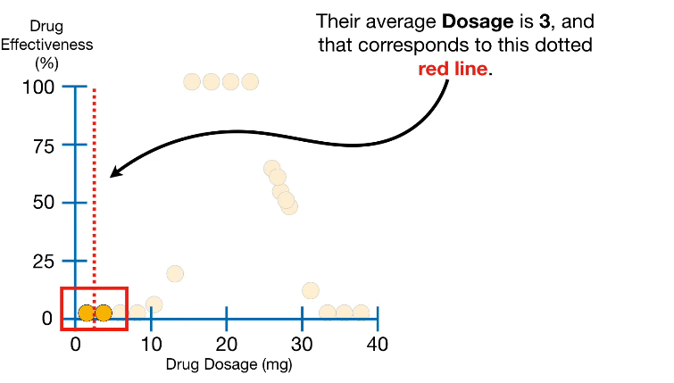
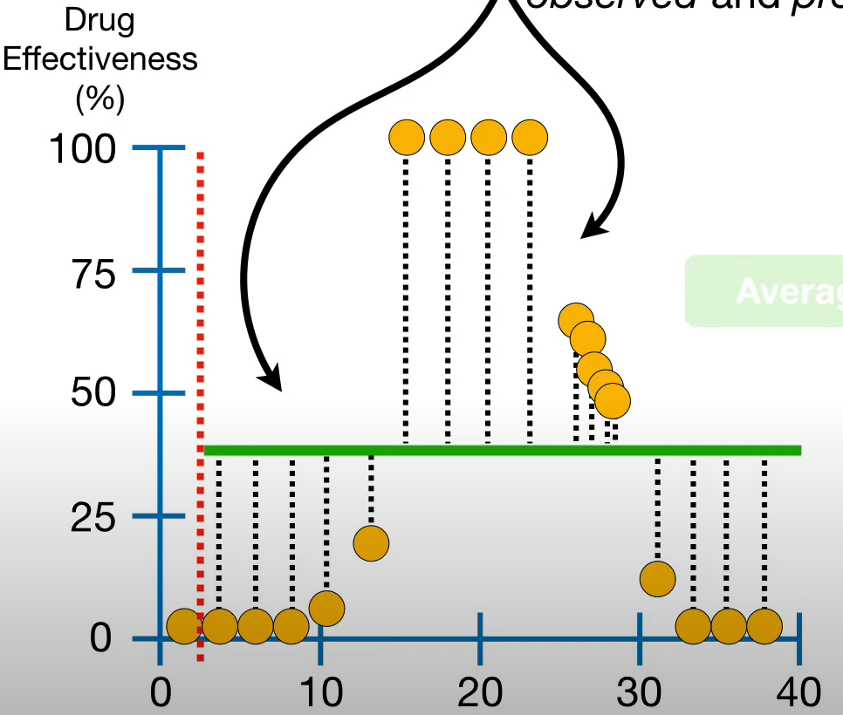
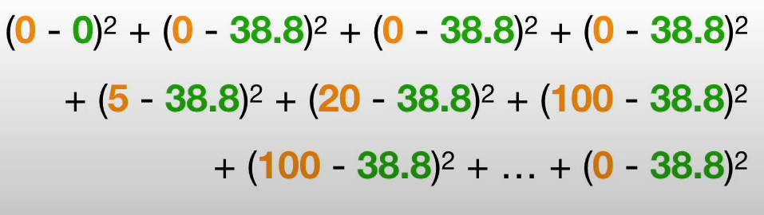
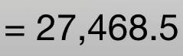
Building Regression Trees
First uses observations as splitting threshold
Then calculates the residuals for the leaves
Then we can calculate the squared residuals for every data point for both partitions.

Slide 36
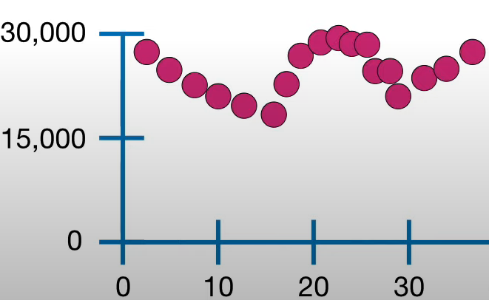
Building Regression Trees
Then we can build a table of sum of squared residuals.
Proceeds to use different threshold partitions and calculate the residuals similar to the previous approach.
Eventually, a table of sum of square residuals to label will be build.

Slide 37
Building Regression Trees
We will keep perform the same routine as classifying trees, where we then walk down to the leaf and calculate the residuals of splitting threshold.
Typically, a number of observations to allow for a split is set for a minimum numbers.
20 is a practical numbers.
For multiple predictors, we then recursively uses different predictors to find the minimum residuals, and then uses the predictor to split the data.

Slide 38
Outline
Decision Trees
Random Forests
Regression Trees
Comparing regression and classification performance
Learning Curves to Training Depths
Diagnosing Training Set Size with Learning Curves
Gaining Insight from Feature Importance

Slide 39
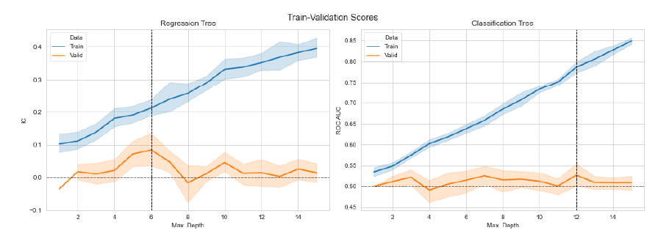
Learning Curves to Training Depths
The regression tree test suggest that the maximum depth of 6 is the best for performance.
The classification tree has the best performance at depth of 12, but similar score can be achieved by depth of 3 or 7, thus we will choose the latter two in avoid of overfitting and complexity.

Slide 40
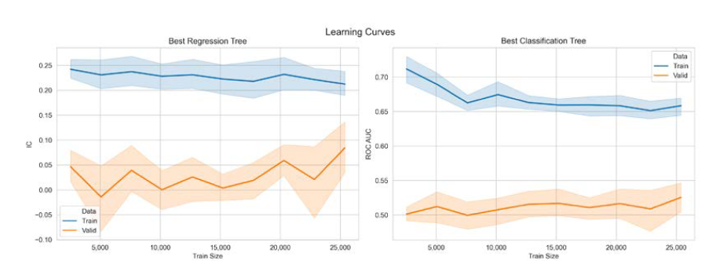
Diagnosing Training Set Size with Learning Curves
The purpose of the learning curve is to find out whether how much the validation score exhibits significant improvement.
The curves suggests that increasing test size increases the performance especially for the regression tree.

Slide 41
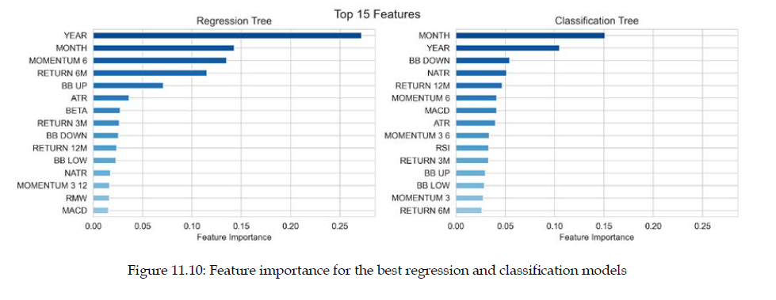
Gaining Insight From Feature Importance
Features importance captures how much the splits produced by each feature help optimize the model’s metric used to evaluate the split quality
Features used earlier in the tree are typically considered of higher importance

Slide 42
Reference
Sebastian Raschka & Vahid Mirjalili (2019) Python Machine Learning 3rd edition, Packt Publishing
StatQuest with Josh Starmer (2019, Aug, 20th) Regression Trees, Clearly Explained [video] youtube.
StatQuest with Josh Starmer (2021, Jul, 6th) Bootstrapping Main Ideas [video] youtube.
StatQuest with Josh Starmer (2018, Jan, 23rd) StatQuest: Decision Trees[video] youtube.
StatQuest with Josh Starmer (2018,Feb, 5th) StatQuest: Random Forests Part 1 - Building, Using and Evaluating [video] youtube.

